Slide 1
Charging impacts for electric vehicles

Slide 2
What can EV consumers learn about battery charging?
Elective Vehicle (EV) purchases have continued to grow since major adoption begin in the United States around 2010. There is a growing concern of “battery charge anxiety” for consumers interested in purchasing an EV.
With this dataset, the goal is to explore what information can be learned about charging duration impacts for interested buyers to better understand.

Slide 3
Dataset
EV battery charging characteristics and duration classification
This dataset contains data related to the charging characteristics of electric vehicle (EV) batteries. The dataset includes various factors affecting battery performance, degradation, and charging duration, along with the target variable representing the optimal charging duration classification. The data is organized with both numerical and categorical features and is designed for analysis or prediction tasks.
https://www.kaggle.com/datasets/ziya07/ev-battery-charging-data

Slide 4
Targeted Dataset variables
SOC %
State-of-Charge of the EV battery, expressed as a percentage. This indicates the current charge level of the battery.
Battery Temp (C*)
The temperature of the battery during charging, measured in degrees Celsius (°C).
Ambient Temp (C*)
The surrounding temperature of the environment in which the EV is being charged.
Charging Duration
The duration (in minutes) of the battery charging process.
Degradation Rate %
A computed value representing the degradation rate of the battery, which affects its overall efficiency and charging capacity. This is calculated based on the charging duration, SOC, and battery temperature.
Charging Cycles
The number of charging cycles the battery has undergone. A charging cycle is counted when the battery goes from full charge to empty and back to full charge.

Slide 5
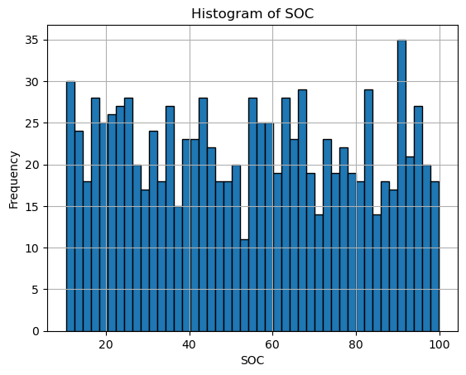
State of charge
SOC Mean: 54.12
SOC Variance: 691.29
SOC Standard Deviation: 26.29
SOC Mode: 0 10.416882 1 10.455543 2 10.496991 3 10.625692 4 10.827735 ... 995 99.145463 996 99.366832 997 99.697315 998 99.718683 999 99.974591
Values should range between 1 – 100. Anything outside of that range should be removed or corrected.

Slide 6
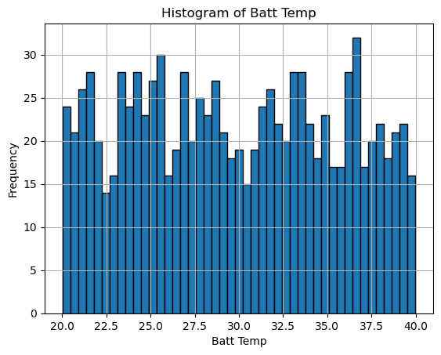
Battery temperature (°C)
Batt Temp Mean: 29.81
Batt Temp Variance: 32.83
Batt Temp Standard Deviation: 5.73
Batt Temp Mode: 0 20.013068 1 20.039843 2 20.106270 3 20.127581 4 20.137559 ... 995 39.943647 996 39.944758 997 39.952566 998 39.977852 999 39.991154
Temperatures that are are physically unrealistic should be removed or corrected.

Slide 7
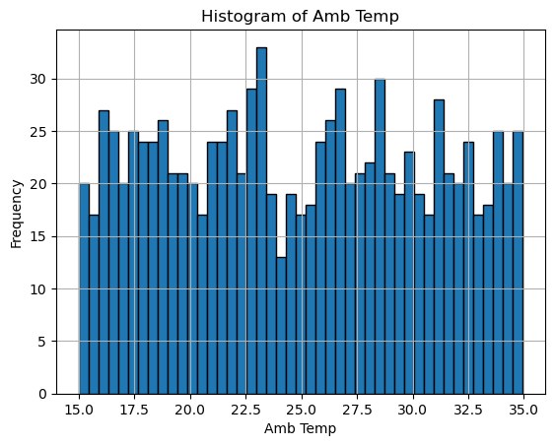
Ambient temperature (°C)
Amb Temp Mean: 24.88
Amb Temp Variance: 32.90
Amb Temp Standard Deviation: 5.74
Amb Temp Mode: 0 15.000614 1 15.004541 2 15.011959 3 15.018868 4 15.022242 ... 995 34.911378 996 34.914689 997 34.930526 998 34.938988 999 34.954988
Temperatures that are are physically unrealistic should be removed or corrected.

Slide 8
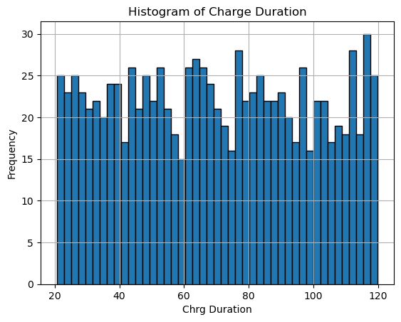
Charging duration (min)
Charge Duration Mean: 69.85
Charge Duration Variance: 836.34
Charge Duration Standard Deviation: 28.92
Charge Duration Mode: 0 20.618382 1 20.709181 2 20.735304 3 20.746314 4 20.861900 ... 995 119.564518 996 119.622449 997 119.767226 998 119.879294 999 119.935030
Any outliers should be reviewed further to understand reasoning for these extremes.

Slide 9
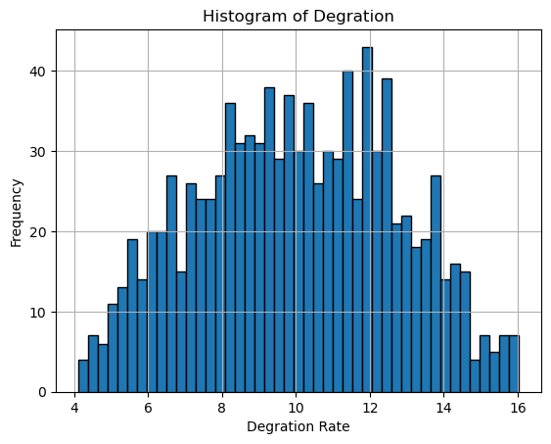
Degradation rate %
Degradation Rate Mean: 10.02
Degradation Rate Variance: 7.27
Degradation Rate Standard Deviation: 2.70
Degradation Rate Mode: 0 4.102433 1 4.126044 2 4.259881 3 4.312585 4 4.418449 ... 995 15.861537 996 15.973104 997 16.006314 998 16.013058 999 16.042788
Ideally, these values should be small. Extreme values should be evaluated further.

Slide 10
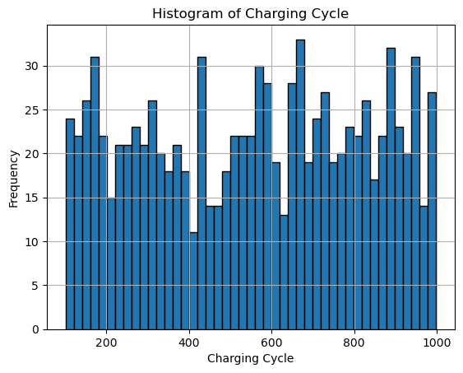
Charging cycles
Charging Cycle Mean: 556.56
Charging Cycle Variance: 69570.95
Charging Cycle Standard Deviation: 263.76
Charging Cycle Mode: 0 516
Outliers should be evaluated for any data entry errors.

Slide 11
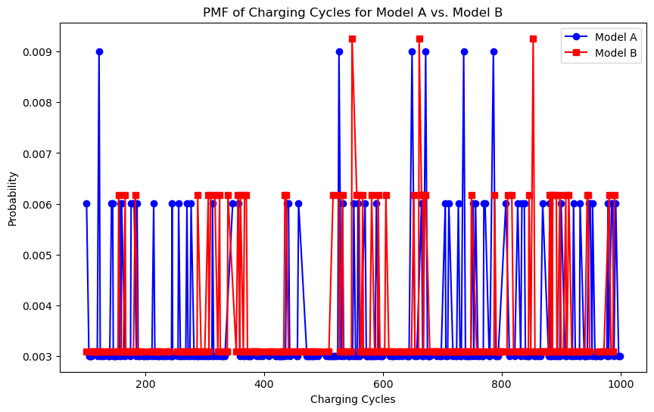
compare two scenarios in your data using a PMF
Both PMFs are similar. Model B has higher peaks, which means it tends to have those number of charging cycles more frequently.

Slide 12
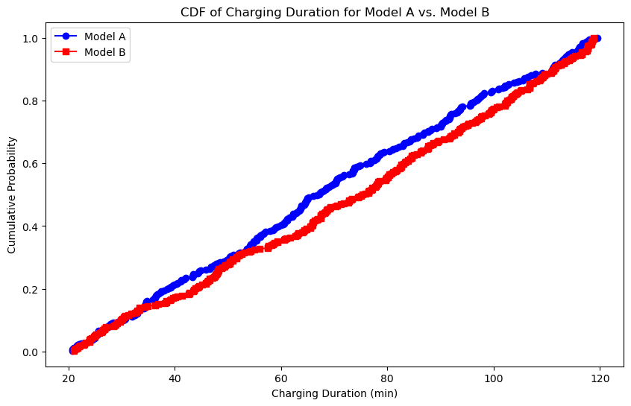
Create a CDF with one of your variables
Model A vehicles show to charge a slightly better than the Model B vehicles.
Their slopes are similar. Further analysis on Model A may be warranted to understand why it outperforms Model B.

Slide 13
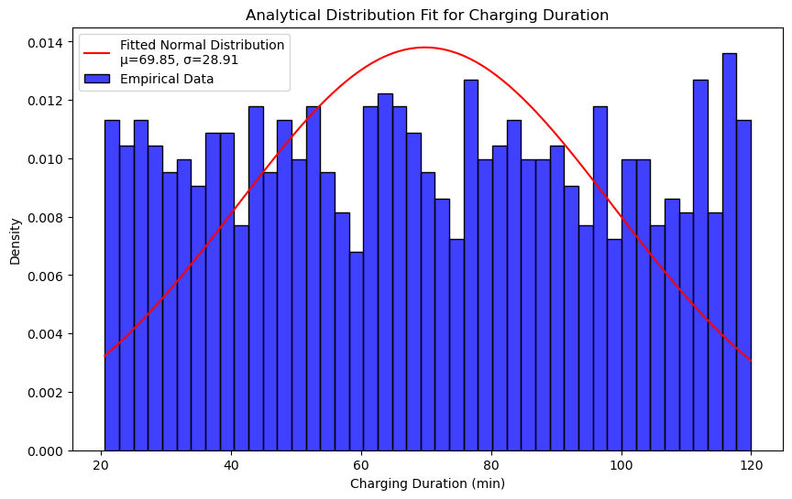
analytical distribution
Mean = 69.85
Standard Deviation = 28.91
There is not a normal distribution. There are multiple peaks, leading us to believe that further analysis is required to understand impacts to Charging Duration, such as battery capacity, technology, and make.

Slide 14
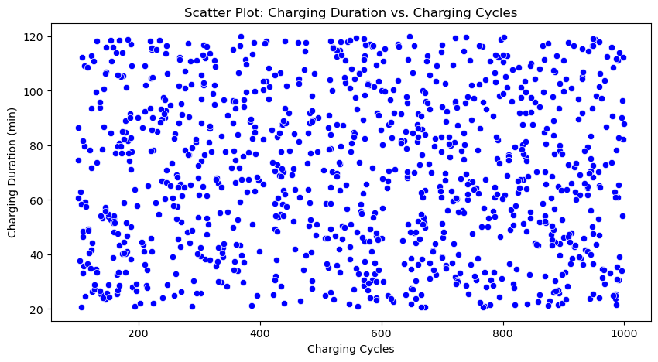
Create two scatter plots comparing two variables and provide your analysis
Pearson Correlation (Charging Duration vs Charging Cycles):
-0.01
There is a week correlation.
As you can see in the plot, there is a non-linear relationship between Charging Duration and Charging Cycles.
Further analysis is needed to better understand this relationship.

Slide 15
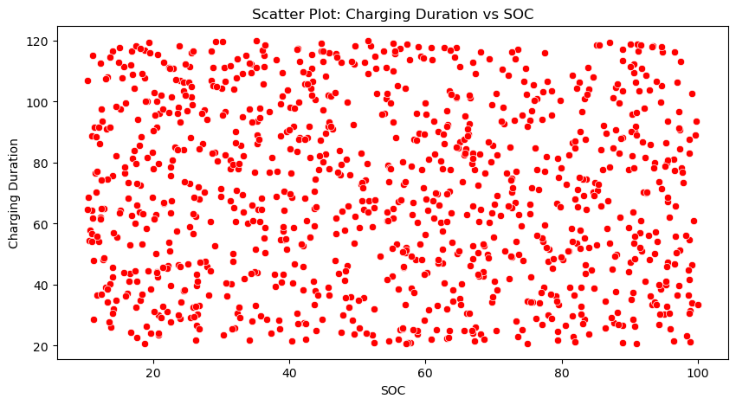
Create two scatter plots comparing two variables and provide your analysis
Pearson Correlation (Charging Duration vs SOC): -0.06
There is a weak relationship.
As you can see in the plot, there is a non-linear relationship between Charging Duration and State of Charge.
Further analysis is needed to better understand this relationship.

Slide 16
Hypothesis test
Hypothesis Test: Compare Mean Charging Duration Between Two Groups (Fast vs Slow Charging)
Fast and Slow charging distributions are not normal, so will calculate Mann-Whitney U Test.
Shapiro-Wilk Test for Fast Charging:
statistic = 0.9613616733923821, pvalue = 1.7799658070056005e-07
Shapiro-Wilk Test for Slow Charging:
statistic = 0.9495564883791464, pvalue = 2.0883805080680235e-09
Mann-Whitney U Test Result:
statistic = 52557.0, pvalue = 0.45420951561271117
The pvalue of .454 means there is no statistically significant different in charging duration between Fast and Slow charging modes.

Slide 17
regression analysis
Dependent Variable: Charging Duration (min)
Explanatory Variable: Current (amps)
R-squared, Adj R-squared, F-statistic, and Prob(F-statistic) show that the current (in amperes) flowing into the battery during the charging process does not contribute to the explaining the variation in charging duration at all.
The independent variable of Current does not have a meaningful relationship with Charging Duration.
OLS Regression Results
========================================
Dep. Variable: charging_duration_min R-squared: 0.000
Model: OLS Adj. R-squared: -0.001
Method: Least Squares F-statistic: 0.4136
Date: Sat, 15 Mar 2025 Prob (F-statistic): 0.520
Time: 11:03:39 Log-Likelihood: -4782.7
No. Observations: 1000 AIC: 9569.
Df Residuals: 998 BIC: 9579.
Df Model: 1
Covariance Type: nonrobust
========================================
coef std err t P>|t| [0.025 0.975]
-----------------------------------------------------------------------
const 71.0888 2.137 33.259 0.000 66.894 75.283
current_a -0.0225 0.035 -0.643 0.520 -0.091 0.046 ================================================
Omnibus: 644.127 Durbin-Watson: 2.056
Prob(Omnibus): 0.000 Jarque-Bera (JB): 58.499
Skew: 0.034 Prob(JB): 1.98e-13
Kurtosis: 1.817 Cond. No. 143.

